Slide 1

NOVA
OLYMPUS
Transformation, Revival, Discovery!
Yavuz Selim Orhan
Necla Tuana Şenoğlu
Ümmügülsüm Arslan
Şevval Abay

Slide 2
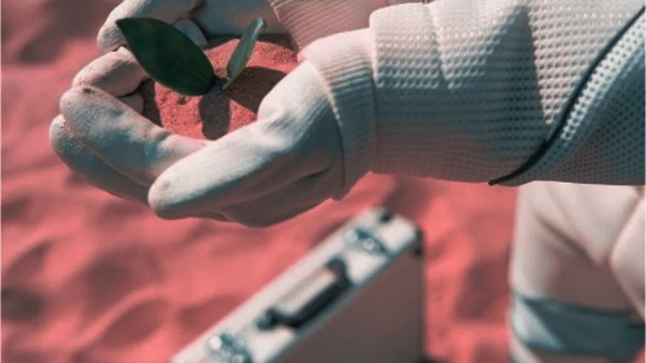
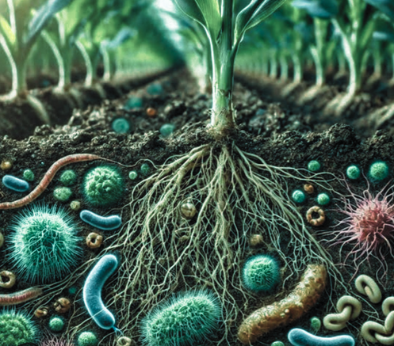
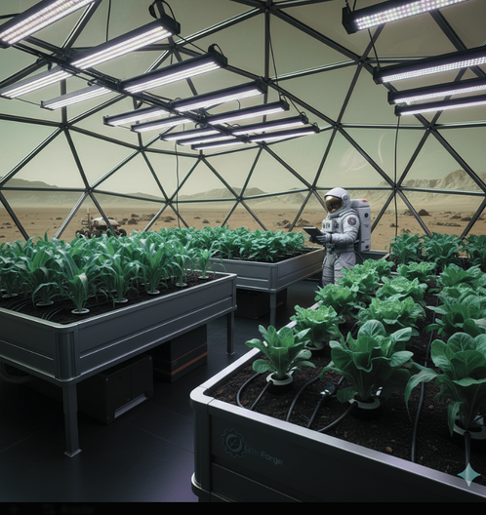
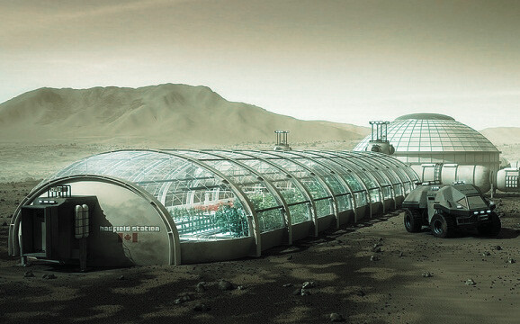
What is the problem?
The inadequacy of waste management and food self-sufficiency for a sustainable Martian settlement.
Purpose;
To obtain fertile fertilizer that can be used for agriculture on Mars and create a sustainable life cycle by recycling textile products and organic waste used in the daily lives of astronauts. We also want to reduce the amount of material sent to Mars and the cost of the mission.

Slide 3
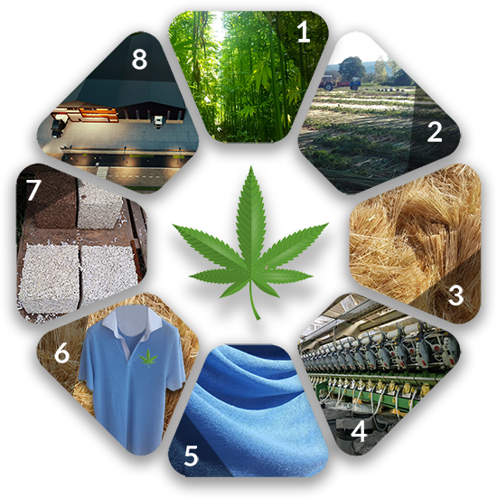


What do we mean by organic waste?
HEMP
“By organic waste used by astronauts, we mean the remains of clothing, towels, and similar textile products used during the mission, which are made of natural, biodegradable materials.
Hemp is less costly to produce and decomposes more quickly than cotton and bamboo.
Hemp nourishes the soil, requires little water, and is also preferred for its fabric because it is:
*Durable
*Breathable
*Antimicrobial.
It increases the organic matter content.
Why Organic Matter?
The reason we prefer organic materials is that after use, clothes and towels can easily dissolve and turn into efficient fertilizer during the composting process. The organic material we have chosen for this project is hemp..

Slide 4

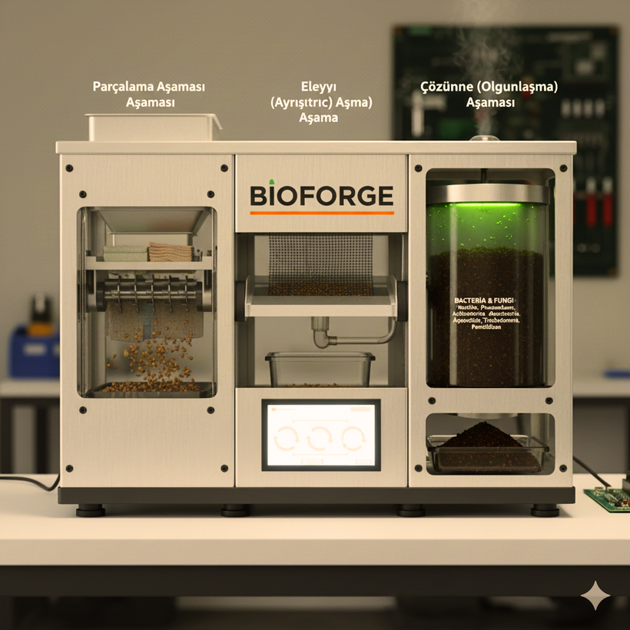

1)Shredding stage
Clothing and towels are shredded into 1–3 cm pieces using a system similar to a meat grinder in the composting machine. This process increases the surface area, accelerating decomposition, making biological breakdown more efficient, and creating a homogeneous mixture that ensures the system operates more smoothly.
2)Keeping Up with Trend
The shredded materials are screened according to their size; large pieces are re-ground, and suitable ones proceed to the composting stage. This ensures homogeneity and increases dissolution efficiency.
Gemini AI
BIOFORGE
What we call a bioforge is a composting machine. It is a system that breaks down the organic materials we make from hemp more quickly using microbacteria. It consists of three stages:
3)Dissolution (Maturation) Stage
Small pieces are broken down by bacteria and fungi, turning into nutrient-rich compost. Fungi break down cellulose and lignin, the resulting gases are converted into energy, and what remains is odorless, stable fertilizer suitable for growing plants.

Slide 5
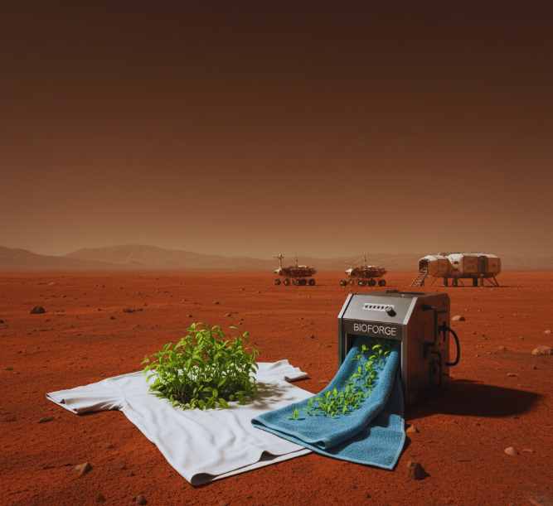



WHAT ARE THE GASES THAT ARE RELEASED, AND WHAT HAPPENS TO THEM?
Methane (CH₄) released during composting is used in energy production, while carbon dioxide (CO₂) is used in plant photosynthesis. Thus, the system creates a sustainable cycle by providing fertilizer, energy, and life support from waste.
Gemini AI
Karbondioksit
Metan
Diğer

Slide 6
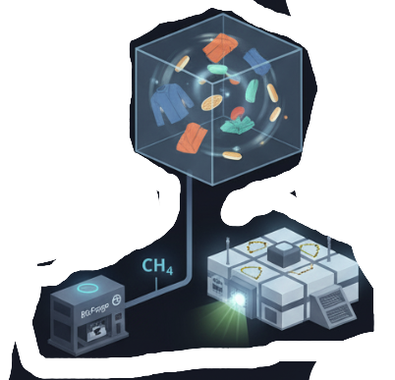
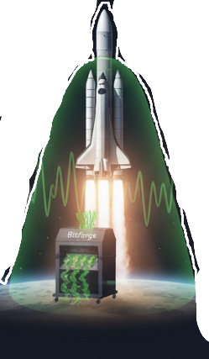
Importance of the Project;
Importance for NASA;
Importance for Mars;
Significant savings will be achieved in the resources and logistical power required for the table to grow plants on Mars. In addition to saving money, 10-15% of the energy required for operations will be met by the methane gas released during composting.
We will enrich the barren Martian soil with our fertilizer by converting the clothing and organic waste used by astronauts into fertilizer, thereby increasing its productivity. As a result, the chances of establishing colonies on Mars will increase.
Gemini AI
Gemini AI

Slide 7

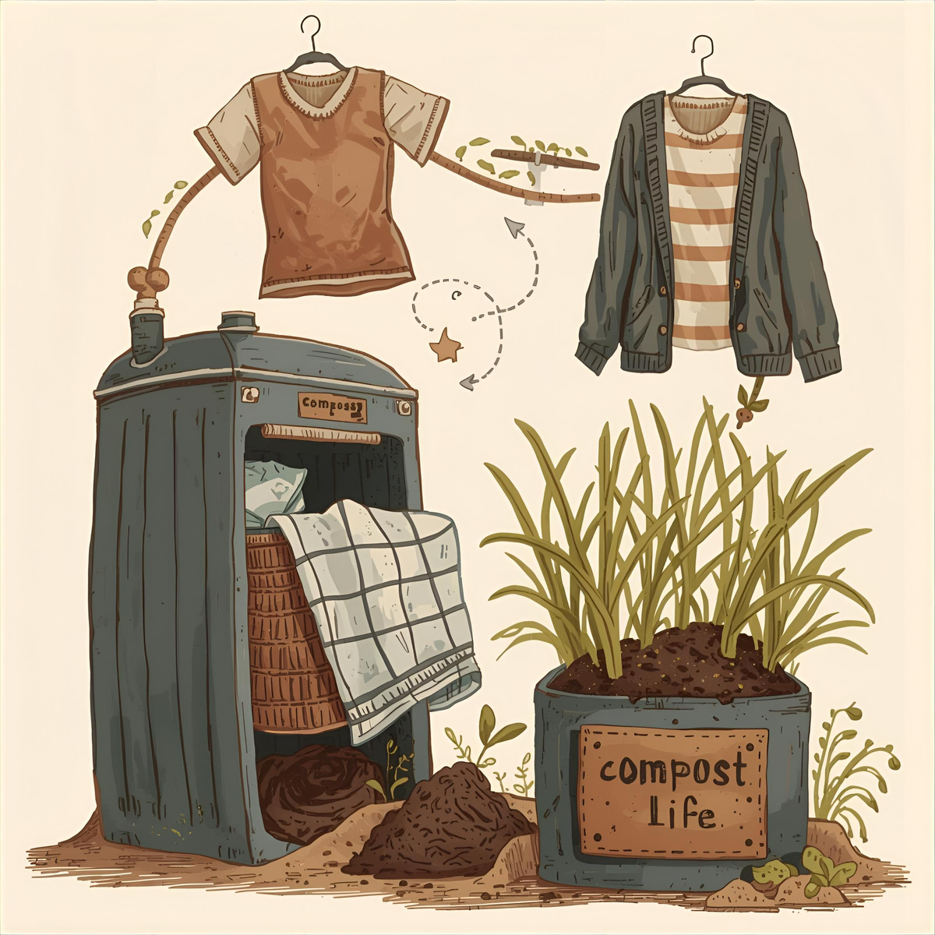
In conclusion;
The Nova Olympus Project recycles astronauts' clothing and towels, preventing them from becoming waste and incorporating them into the life cycle. The composting machine breaks down these materials and converts them into fertilizer and energy. The methane and carbon dioxide produced are used for energy generation and agriculture on Mars, creating a sustainable system.
Canva AI
Thank You...

